Slide 1
UNIVERSITY INSTITUTE OF COMPUTING
MASTER OF COMPUTER APPLICATIONS
Design and Analysis of Algorithms
24CAT-611
DISCOVER . LEARN . EMPOWER

Slide 2
0/1 Knapsack Problem
In 0/1 Knapsack Problem,
As the name suggests, items are indivisible here.
We can not take the fraction of any item.
We have to either take an item completely or leave it completely.
It is solved using dynamic programming approach.

Slide 3
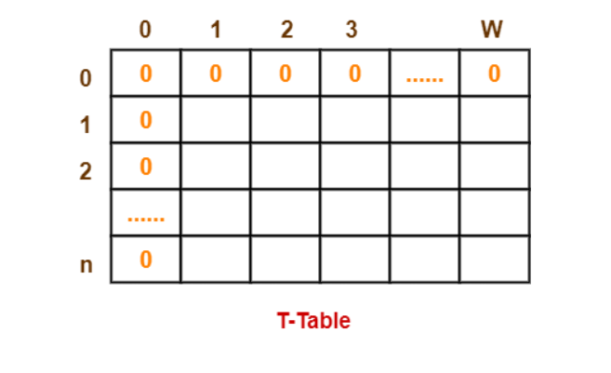
0/1 Knapsack Problem Using Dynamic Programming
Consider-
Knapsack weight capacity = w
Number of items each having some weight and value = n
0/1 knapsack problem is solved using dynamic programming in the following steps-
Step-01:
Draw a table say ‘T’ with (n+1) number of rows and (w+1) number of columns.
Fill all the boxes of 0th row and 0th column with zeroes as shown-

Slide 4
Step-02:
Start filling the table row wise top to bottom from left to right.
Use the following formula-
T (i , j) = max { T ( i-1 , j ) , value_{i} + T( i-1 , j – weight_{i} ) }
Here, T(i , j) = maximum value of the selected items if we can take items 1 to i and have weight restrictions of j.
This step leads to completely filling the table.
Then, value of the last box represents the maximum possible value that can be put into the knapsack.

Slide 5
Step-03:
To identify the items that must be put into the knapsack to obtain that maximum profit,
Consider the last column of the table.
Start scanning the entries from bottom to top.
On encountering an entry whose value is not same as the value stored in the entry immediately above it, mark the row label of that entry.
After all the entries are scanned, the marked labels represent the items that must be put into the knapsack.

Slide 6
Time Complexity-
Each entry of the table requires constant time θ(1) for its computation.
It takes θ(nw) time to fill (n+1)(w+1) table entries.
It takes θ(n) time for tracing the solution since tracing process traces the n rows.
Thus, overall θ(nw) time is taken to solve 0/1 knapsack problem using dynamic programming.

Slide 7
Example
For the given set of items and knapsack capacity = 5 kg,
find the optimal solution for the 0/1 knapsack problem making use of dynamic programming approach.
Item | Weight | Value
1 | 2 | 3
2 | 3 | 4
3 | 4 | 5
4 | 5 | 6

Slide 8
Example
Find the optimal solution for the 0/1 knapsack problem making use of dynamic programming approach. Consider-
n = 4
w = 5 kg
(w1, w2, w3, w4) = (2, 3, 4, 5)
(b1, b2, b3, b4) = (3, 4, 5, 6)

Slide 9
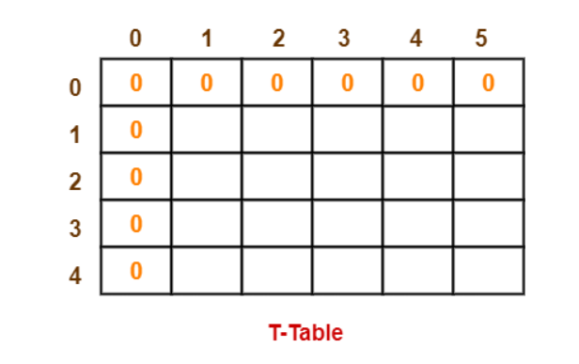
Solution
Given-
Knapsack capacity (w) = 5 kg
Number of items (n) = 4
Step-01:
Draw a table say ‘T’ with (n+1) = 4 + 1 = 5 number of rows and (w+1) = 5 + 1 = 6 number of columns.
Fill all the boxes of 0th row and 0th column with 0.

Slide 10
Working Procedure
Step-02:
Start filling the table row wise top to bottom from left to right using the formula-
T (i , j) = max { T ( i-1 , j ) , value_{i} + T( i-1 , j – weight_{i} ) }
Finding T(1,1)-
We have,
i = 1
j = 1
(value)_{i} = (value)₁ = 3
(weight)_{i} = (weight)₁ = 2
Substituting the values, we get-
T(1,1) = max { T(1-1 , 1) , 3 + T(1-1 , 1-2) }
T(1,1) = max { T(0,1) , 3 + T(0,-1) }
T(1,1) = T(0,1) { Ignore T(0,-1) }
T(1,1) = 0

Slide 11
Working procedure
Finding T(1,2)-
We have,
i = 1
j = 2
(value)_{i} = (value)₁ = 3
(weight)_{i} = (weight)₁ = 2
Substituting the values, we get-
T(1,2) = max { T(1-1 , 2) , 3 + T(1-1 , 2-2) }
T(1,2) = max { T(0,2) , 3 + T(0,0) }
T(1,2) = max {0 , 3+0}
T(1,2) = 3

Slide 12
Working procedure
Finding T(1,3)-
We have,
i = 1
j = 3
(value)_{i} = (value)₁ = 3
(weight)_{i} = (weight)₁ = 2
Substituting the values, we get-
T(1,3) = max { T(1-1 , 3) , 3 + T(1-1 , 3-2) }
T(1,3) = max { T(0,3) , 3 + T(0,1) }
T(1,3) = max {0 , 3+0}
T(1,3) = 3

Slide 13
Working procedure
Finding T(1,4)-
We have,
i = 1
j = 4
(value)_{i} = (value)₁ = 3
(weight)_{i} = (weight)₁ = 2
Substituting the values, we get-
T(1,4) = max { T(1-1 , 4) , 3 + T(1-1 , 4-2) }
T(1,4) = max { T(0,4) , 3 + T(0,2) }
T(1,4) = max {0 , 3+0}
T(1,4) = 3

Slide 14
Working procedure
Finding T(1,5)-
We have,
i = 1
j = 5
(value)_{i} = (value)₁ = 3
(weight)_{i} = (weight)₁ = 2
Substituting the values, we get-
T(1,5) = max { T(1-1 , 5) , 3 + T(1-1 , 5-2) }
T(1,5) = max { T(0,5) , 3 + T(0,3) }
T(1,5) = max {0 , 3+0}
T(1,5) = 3

Slide 15
Working procedure
Finding T(2,1)-
We have,
i = 2
j = 1
(value)_{i} = (value)₂ = 4
(weight)_{i} = (weight)₂ = 3
Substituting the values, we get-
T(2,1) = max { T(2-1 , 1) , 4 + T(2-1 , 1-3) }
T(2,1) = max { T(1,1) , 4 + T(1,-2) }
T(2,1) = T(1,1) { Ignore T(1,-2) }
T(2,1) = 0

Slide 16
Working procedure
Finding T(2,2)-
We have,
i = 2
j = 2
(value)_{i} = (value)₂ = 4
(weight)_{i} = (weight)₂ = 3
Substituting the values, we get-
T(2,2) = max { T(2-1 , 2) , 4 + T(2-1 , 2-3) }
T(2,2) = max { T(1,2) , 4 + T(1,-1) }
T(2,2) = T(1,2) { Ignore T(1,-1) }
T(2,2) = 3

Slide 17
Working procedure
Finding T(2,3)-
We have,
i = 2
j = 3
(value)_{i} = (value)₂ = 4
(weight)_{i} = (weight)₂ = 3
Substituting the values, we get-
T(2,3) = max { T(2-1 , 3) , 4 + T(2-1 , 3-3) }
T(2,3) = max { T(1,3) , 4 + T(1,0) }
T(2,3) = max { 3 , 4+0 }
T(2,3) = 4

Slide 18
Working procedure
Finding T(2,4)-
We have,
i = 2
j = 4
(value)_{i} = (value)₂ = 4
(weight)_{i} = (weight)₂ = 3
Substituting the values, we get-
T(2,4) = max { T(2-1 , 4) , 4 + T(2-1 , 4-3) }
T(2,4) = max { T(1,4) , 4 + T(1,1) }
T(2,4) = max { 3 , 4+0 }
T(2,4) = 4

Slide 19
Working procedure
Finding T(2,5)-
We have,
i = 2
j = 5
(value)_{i} = (value)₂ = 4
(weight)_{i} = (weight)₂ = 3
Substituting the values, we get-
T(2,5) = max { T(2-1 , 5) , 4 + T(2-1 , 5-3) }
T(2,5) = max { T(1,5) , 4 + T(1,2) }
T(2,5) = max { 3 , 4+3 }
T(2,5) = 7

Slide 20
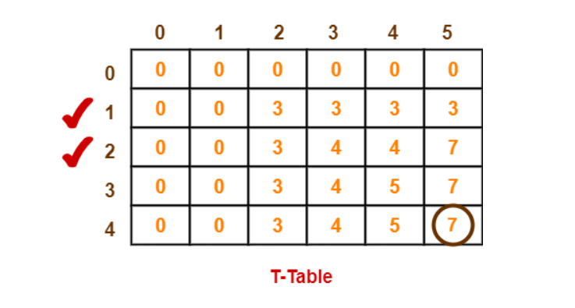
Working procedure
Similarly, compute all the entries.
After all the entries are computed and filled in the table, we get the following table-
The last entry represents the maximum possible value that can be put into the knapsack.
So, maximum possible value that can be put into the knapsack = 7.

Slide 21
Identifying Items To Be Put Into Knapsack-
Following Step-04,
We mark the rows labelled “1” and “2”.
Thus, items that must be put into the knapsack to obtain the maximum value 7 are-
Item-1 and Item-2

Slide 22
References
https://www.gatevidyalay.com/tag/0-1-knapsack-problem-ppt/
Books:
Introduction to Algorithms by Coreman, Leiserson, Rivest, Stein.
Fundamentals of Algorithms by Ellis Horwitz
Computer Algorithms/C++ by Sartaj Sahni, Sanguthevar Rajasekaran

Slide 23
THANK YOU

